Slide 1
Design Pattern

Slide 2
Iterator Pattern
In object-oriented programming, the iterator pattern is a design pattern in which an iterator is used to traverse a container and access the container's elements. The iterator pattern decouples algorithms from containers; in some cases, algorithms are necessarily container-specific and thus cannot be decoupled.
For example, the hypothetical algorithm SearchForElement can be implemented generally using a specified type of iterator rather than implementing it as a container-specific algorithm. This allows SearchForElement to be used on any container that supports the required type of iterator.

Slide 3
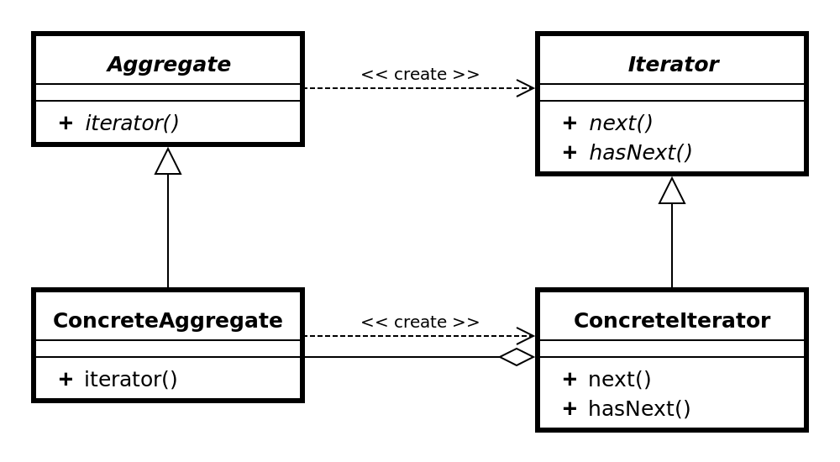
Iterator Pattern Cont.

Slide 4
Iterator Pattern Cont.
function reverseArrayIterator(array)
{ var index = array.length - 1;
return
{ next: () =>
index >= 0 ?
{value: array[index--], done: false} :
{done: true} } }
const it = reverseArrayIterator(['three', 'two', 'one']); console.log(it.next().value); //-> 'one' console.log(it.next().value); //-> 'two' console.log(it.next().value); //-> 'three'
console.log(`Are you done? ${it.next().done}`); //-> true

Slide 5
Link
https://en.wikipedia.org/wiki/Iterator_pattern

Slide 6
Strategic Pattern
In computer programming, the strategy pattern (also known as the policy pattern) is a behavioural software design pattern that enables to select an algorithm at runtime. The strategy pattern
defines a family of algorithms,
encapsulates each algorithm, and
makes the algorithms interchangeable within that family.
Strategy lets the algorithm vary independently from clients that use it.^{[1]} Strategy is one of the patterns included in the influential book Design Patterns by Gamma et al. that popularized the concept of using design patterns to describe how to design flexible and reusable object-oriented software.

Slide 7
Strategic Pattern cont.
For instance, a class that performs validation on incoming data may use the Strategy pattern to select a validation algorithm depending on the type of data, the source of the data, user choice, or other discriminating factors. These factors are not known until run-time and may require radically different validation to be performed. The validation algorithms (strategies), encapsulated separately from the validating object, may be used by other validating objects in different areas of the system (or even different systems) without code duplication.
The essential requirement to implement the Strategy pattern is the ability to store a reference to some code in a data structure and retrieve it. This can be achieved by mechanisms such as the native function pointer, the first-class function, classes or class instances in object-oriented programming languages, or accessing the language implementation's internal storage of code via reflection.

Slide 8
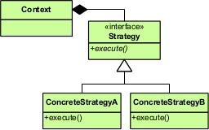
Strategic Pattern cont.

Slide 9
Strategic Pattern cont.
Open/Closed Principle
According to the strategy pattern, the behaviors of a class should not be inherited. Instead they should be encapsulated using interfaces. As an example, consider a car class. Two possible functionalities for car are brake and accelerate.
Since accelerate and brake behaviors change frequently between models, a common approach is to implement these behaviors in subclasses. This approach has significant drawbacks: accelerate and brake behaviors must be declared in each new Car model. The work of managing these behaviors increases greatly as the number of models increases, and requires code to be duplicated across models. Additionally, it is not easy to determine the exact nature of the behavior for each model without investigating the code in each.
The strategy pattern uses composition instead of inheritance. In the strategy pattern, behaviors are defined as separate interfaces and specific classes that implement these interfaces. This allows better decoupling between the behavior and the class that uses the behavior. The behavior can be changed without breaking the classes that use it, and the classes can switch between behaviors by changing the specific implementation used without requiring any significant code changes. Behaviors can also be changed at run-time as well as at design-time. For instance, a car object’s brake behavior can be changed from BrakeWithABS() to Brake() by changing the brakeBehavior member to:

Slide 10
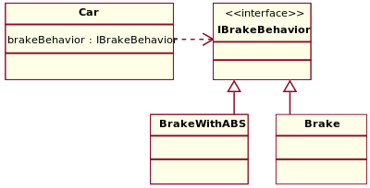
Strategic Pattern cont.

Slide 11
Strategic Pattern cont.
/* Encapsulated family of Algorithms
* Interface and its implementations */
public interface IBrakeBehavior {
public void brake();
}
public class BrakeWithABS implements IBrakeBehavior {
public void brake() {
System.out.println("Brake with ABS applied");
}
}
public class Brake implements IBrakeBehavior {
public void brake() {
System.out.println("Simple Brake applied");
}
}

Slide 12
Strategic Pattern cont.
/* Using the Car example */
public class CarExample {
public static void main(final String[] arguments) {
Car sedanCar = new Sedan();
sedanCar.applyBrake(); // This will invoke class "Brake" Car suvCar = new SUV();
suvCar.applyBrake(); // This will invoke class "BrakeWithABS" // set brake behavior dynamically
suvCar.setBrakeBehavior( new Brake() );
suvCar.applyBrake(); // This will invoke class "Brake" } }

Slide 13
Strategic Pattern cont.
/* Client that can use the algorithms above interchangeably */
public abstract class Car {
protected IBrakeBehavior brakeBehavior;
public void applyBrake() {
brakeBehavior.brake();
}
public void setBrakeBehavior(final IBrakeBehavior brakeType) {
this.brakeBehavior = brakeType;
}
}

Slide 14
Strategic Pattern cont.
/* Client 1 uses one algorithm (Brake) in the constructor */
public class Sedan extends Car { public Sedan() {
this.brakeBehavior = new Brake();
}
}
/* Client 2 uses another algorithm (BrakeWithABS) in the constructor */
public class SUV extends Car { public SUV() {
this.brakeBehavior = new BrakeWithABS();
}
}
This gives greater flexibility in design and is in harmony with the Open/closed principle (OCP) that states that classes should be open for extension but closed for modification.

Slide 15
Link
https://en.wikipedia.org/wiki/Strategy_pattern

Slide 16
Command Pattern
In object-oriented programming, the command pattern is a behavioral design pattern in which an object is used to encapsulate all information needed to perform an action or trigger an event at a later time. This information includes the method name, the object that owns the method and values for the method parameters.
Four terms always associated with the command pattern are command
receiver
invoker and
client.

Slide 17
Command Pattern Cont.
A command object knows about receiver and invokes a method of the receiver. Values for parameters of the receiver method are stored in the command, the receiver object to execute these methods is also stored in the command object by aggregation.
The receiver then does the work when the execute() method in command is called. An invoker object knows how to execute a command, and optionally does bookkeeping about the command execution.
The invoker does not know anything about a concrete command, it knows only about command interface. Invoker object(s), command objects and receiver objects are held by a client object.

Slide 18
Command Pattern Cont.
The client decides which receiver objects it assigns to the command objects, and which commands it assigns to the invoker. The client decides which commands to execute at which points. To execute a command, it passes the command object to the invoker object.

Slide 19
Command Pattern Cont.
Using command objects makes it easier to construct general components that need to delegate, sequence or execute method calls at a time of their choosing without the need to know the class of the method or the method parameters. Using an invoker object allows bookkeeping about command executions to be conveniently performed, as well as implementing different modes for commands, which are managed by the invoker object, without the need for the client to be aware of the existence of bookkeeping or modes.

Slide 20
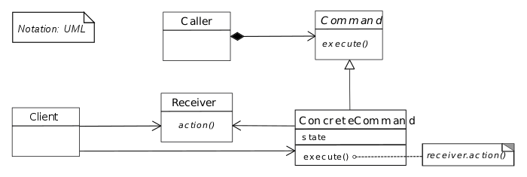
Command Pattern Cont.

Slide 21
Command Pattern Cont.
import java.util.List;
import java.util.ArrayList;
/** The Command interface */
public interface Command {
void execute();
}
/** The Invoker class */
public class Switch {
private List<Command> history = new ArrayList<Command>(); public void storeAndExecute(final Command cmd) { this.history.add(cmd); // optional
cmd.execute();
}
}

Slide 22
Command Pattern Cont
/** The Receiver class */
public class Light {
public void turnOn() {
System.out.println("The light is on");
}
public void turnOff() {
System.out.println("The light is off");
}
}

Slide 23
Command Pattern Cont
/** The Command for turning on the light –Concrete
Command #1 */
public class FlipUpCommand implements Command {
private Light theLight;
public FlipUpCommand(final Light light) {
this.theLight = light;
}
@Override // Command
public void execute() {
theLight.turnOn();
}
}

Slide 24
Command Pattern Cont.
/** The Command for turning off the light - ConcreteCommand #2 */
public class FlipDownCommand implements Command { private Light theLight;
public FlipDownCommand(final Light light) {
this.theLight = light;
} @Override // Command
public void execute() {
theLight.turnOff();
}
}

Slide 25
Command Pattern Cont.
/* The test class or client */
public class PressSwitch {
public static void main(final String[] arguments){
// Check number of arguments
if (arguments.length != 1) {
System.err.println("Argument \"ON\" or \"OFF\" is required.");
System.exit(-1);
}
final Command switchUp = new FlipUpCommand(lamp);
final Command switchDown = new FlipDownCommand(lamp);
final Switch mySwitch = new Switch();
switch(arguments[0]) {
case "ON": mySwitch.storeAndExecute(switchUp);
break;
case "OFF": mySwitch.storeAndExecute(switchDown);
break; default:
System.err.println("Argument \"ON\" or \"OFF\" is required.");
System.exit(-1);
}
}
}

Slide 26
Link
https://en.wikipedia.org/wiki/Command_pattern

Slide 27
Decorator Pattern
In object-oriented programming, the decorator pattern (also known as Wrapper, an alternative naming shared with the Adapter pattern) is a design pattern that allows behavior to be added to an individual object, either statically or dynamically, without affecting the behavior of other objects from the same class.
The decorator pattern is often useful for adhering to the Single Responsibility Principle, as it allows functionality to be divided between classes with unique areas of concern.

Slide 28
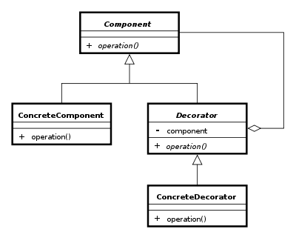
Decorator Pattern Cont.

Slide 29
Decorator Pattern Cont.
// The interface Coffee defines the functionality of Coffee implemented by decorator
public interface Coffee { public double getCost();
// Returns the cost of the coffee
public String getIngredients();
// Returns the ingredients of the coffee
}
// Extension of a simple coffee without any extra ingredients public class SimpleCoffee implements Coffee {
@Override
public double getCost() {
return 1;
}
@Override
public String getIngredients() {
return "Coffee";
}
}

Slide 30
Decorator Pattern Cont.
// Abstract decorator class - note that it implements Coffee interface
public abstract class CoffeeDecorator implements Coffee { protected final Coffee decoratedCoffee;
public CoffeeDecorator(Coffee c) {
this.decoratedCoffee = c;
}
public double getCost() {
// Implementing methods of the interface
return decoratedCoffee.getCost();
}
public String getIngredients() {
return decoratedCoffee.getIngredients();
}
}

Slide 31
Decorator Pattern Cont.
// Decorator WithMilk mixes milk into coffee.
// Note it extends CoffeeDecorator.
class WithMilk extends CoffeeDecorator {
public WithMilk(Coffee c) {
super(c);
}
public double getCost() {
// Overriding methods defined in the abstract superclass return super.getCost() + 0.5;
}
public String getIngredients() {
return super.getIngredients() + ", Milk";
}
}

Slide 32
Decorator Pattern Cont.
// Decorator WithSprinkles mixes sprinkles onto coffee.
// Note it extends CoffeeDecorator.
class WithSprinkles extends CoffeeDecorator {
public WithSprinkles(Coffee c) {
super(c);
}
public double getCost() {
return super.getCost() + 0.2;
}
public String getIngredients() {
return super.getIngredients() + ", Sprinkles";
}
}

Slide 33
Decorator Pattern Cont.
public class Main {
public static void printInfo(Coffee c) { System.out.println("Cost: " + c.getCost() + "; Ingredients: " + c.getIngredients());
}
public static void main(String[] args) {
Coffee c = new SimpleCoffee();
printInfo(c);
c = new WithMilk(c);
printInfo(c);
c = new WithSprinkles(c);
printInfo(c);
}
}

Slide 34
Link
https://en.wikipedia.org/wiki/Decorator_pattern

Slide 35
Twin Pattern
In software engineering, the Twin pattern is a software design pattern that allows developers to model multiple inheritance in programming languages that do not support multiple inheritance. This pattern avoids many of the problems with multiple inheritance.

Slide 36
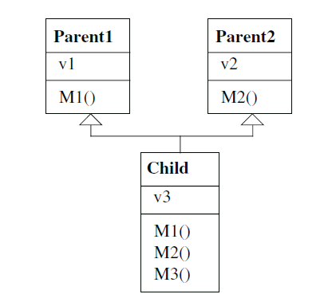
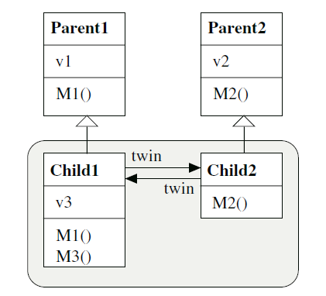
Twin Pattern Cont.

Slide 37
Twin Pattern Cont.
public class Gameboard extends Canvas {
public int width, height;
public GameItem firstItem; …
}
public abstract class GameItem {
Gameboard board;
int posX, posY;
GameItem next;
public abstract void draw();
public abstract void click (MouseEvent e);
public abstract boolean intersects (GameItem other);
public abstract void collideWith (GameItem other);
public void check() {
GameItem x;
for (x = board.firstItem; x != null; x = x.next)
if (intersects(x)) collideWith(x);
}

Slide 38
Twin Pattern Cont.
public static BallItem newBall (int posX, int posY, int radius) {
//method of GameBoard BallItem ballItem = new BallItem(posX, posY, radius);
BallThread ballThread = new BallThread();
ballItem.twin = ballThread;
ballThread.twin = ballItem;
return ballItem;
}
}

Slide 39
Twin Pattern Cont.
public class BallItem extends GameItem {
BallThread twin;
int radius;
int dx, dy;
boolean suspended;
public void draw() {
board.getGraphics().drawOval(posX-radius, posY-radius, 2*radius, 2*radius); }
public void move() {
posX += dx; posY += dy;
}
public void click() {
if (suspended) twin.resume();
else twin.suspend();
suspended = ! suspended;
}

Slide 40
Twin Pattern Cont.
public boolean intersects (GameItem other) {
if (other instanceof Wall)
return posX - radius <= other.posX
&& other.posX <= posX + radius
|| posY - radius <= other.posY
&& other.posY <= posY + radius;
else
return false;
}
public void collideWith (GameItem other) {
Wall wall = (Wall) other;
if (wall.isVertical)
dx = - dx;
Else
dy = - dy;
}
}

Slide 41
public class BallThread extends Thread {
BallItem twin;
public void run() {
while (true) {
twin.draw();
/*erase*/
twin.move();
twin.draw();
}
}
}

Slide 42
Link
https://en.wikipedia.org/wiki/Twin_pattern

